Slide 1
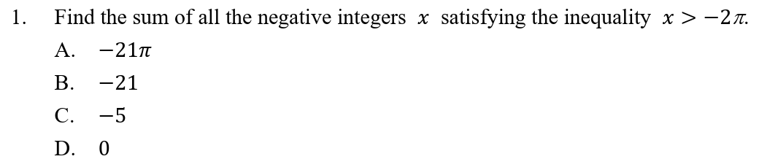



















$$\text{x}$$
$$>$$
$$−\text{2}π$$
$$\text{x}$$
$$>$$
$$−\text{6.28}∙∙∙$$
$$∵$$
The negative integers satisfying the inequality are $−\text{6,}$ $−\text{5}\text{,}$ $−\text{4}\text{,}−\text{3}\text{,}$ $−\text{2 }\text{a}\text{nd} −\text{1.}$
$$∴$$
The required sum
$$=$$
$$−$$
$$+$$
$$−$$
$$+$$
$$−$$
$$+$$
$$−$$
$$+$$
$$+$$
(
6)
(
(
4)
(
$$−$$
$$−$$
5)
3)
(
2)
(
1)
$$=$$
$$−\text{21}$$
B

Slide 2
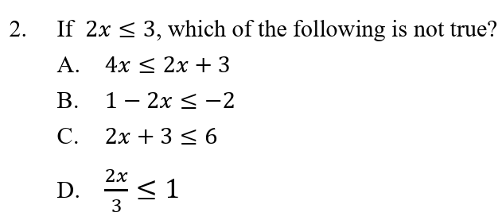


























































A:
$$\text{2}\text{x}$$
$$≤$$
$$\text{3}$$
C:
$$\text{2}\text{x}$$
$$≤$$
$$\text{3}$$
$$\text{2}\text{x}$$
$$+$$
$$\text{2}\text{x}$$
$$≤$$
$$\text{2}\text{x}$$
$$+$$
$$\text{3}$$
$$\text{2}\text{x}$$
$$+$$
$$\text{3}$$
$$≤$$
$$\text{3}$$
$$+$$
$$\text{3}$$
$$\text{4}\text{x}$$
$$≤$$
$$\text{2}\text{x}$$
$$+$$
$$\text{3}$$
$$\text{2}\text{x}$$
$$+$$
$$\text{3}$$
$$≤$$
$$\text{6}$$
B:
$$\text{2}\text{x}$$
$$≤$$
$$\text{3}$$
D:
$$\text{2}\text{x}$$
$$≤$$
$$\text{3}$$
$$−\text{2}\text{x}$$
$$≥$$
$$−\text{3}$$
2x
3
$$≤$$
$$\text{1}$$
$$−$$
$$\text{2}\text{x}$$
$$≥$$
$$\text{1}$$
$$−$$
$$\text{3}$$
3
3
$$\text{1}$$
$$−$$
$$\text{2}\text{x}$$
$$≥$$
$$−\text{2}$$
2x
$$≤$$
$$\text{1}$$
$$∴$$
3
The given inequality is not true
$$∴$$
B is not true
B

Slide 3
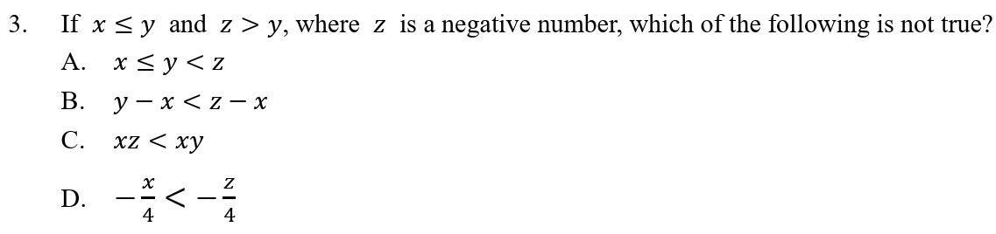






































































A:
$$∵$$
$$\text{x}$$
$$≤$$
$$\text{y}$$
and
$$\text{y}$$
$$<$$
$$\text{z}$$
D:
$$∵$$
$$\text{x}$$
$$≤$$
$$\text{y}$$
$$<$$
$$\text{z}$$
$$∴$$
$$\text{x}$$
$$≤$$
$$\text{y}$$
$$<$$
$$\text{z}$$
$$∴$$
$$−\text{x}$$
$$>$$
$$−\text{z}$$
$$\text{x}$$
$$\text{z}$$
$$−$$
$$>$$
$$−$$
B:
$$∵$$
$$\text{y}$$
$$<$$
$$\text{z}$$
4
4
$$∴$$
$$\text{y}$$
$$−$$
$$\text{x}$$
$$<$$
$$\text{z}$$
$$−$$
$$∴$$
The given inequality is not true
$$\text{x}$$
$$∴$$
D is not true
C:
$$∵$$
$$\text{x}$$
$$≤$$
$$\text{y}$$
$$<$$
$$\text{z}$$
and
$$\text{z}$$
$$<$$
$$\text{0}$$
$$∴$$
$$\text{x}$$
$$<$$
D
$$\text{0}$$
$$∵$$
$$\text{y}$$
$$<$$
$$\text{z}$$
and
$$\text{x}$$
$$<$$
$$\text{0}$$
$$∴$$
$$\text{x}\text{z}$$
$$<$$
$$\text{x}\text{y}$$

Slide 4
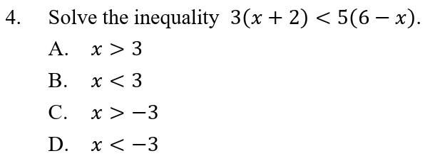



























(
$$+$$
$$<$$
$$−$$
3
$$\text{x}$$
$\text{2}$)
(
$\text{x}$)
5
$$\text{6}$$
$$\text{3}\text{x}$$
$$+$$
$$\text{6}$$
$$<$$
$$\text{30}$$
$$−$$
$$\text{5}\text{x}$$
$$\text{3}\text{x}$$
$$+$$
$$\text{5}\text{x}$$
$$<$$
$$\text{30}$$
$$−$$
$$\text{6}$$
$$\text{8}\text{x}$$
$$<$$
$$\text{24}$$
$$\text{x}$$
$$<$$
$$\text{3}$$
B

Slide 5
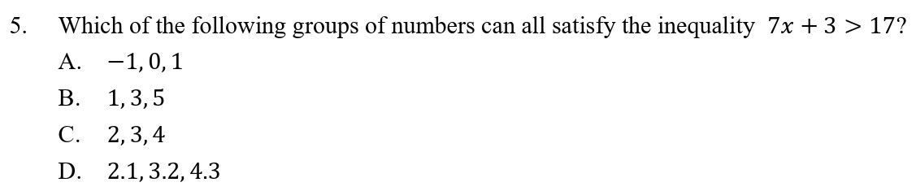





































The answer is D.
$$\text{R}\text{.}\text{H}\text{.}\text{S}\text{.}$$
$$=$$
17
$$\text{When}$$
$$\text{x}$$
$$=$$
2.1 ,
$\text{L}\text{.}\text{H}\text{.}\text{S}$.
$$=$$
7
$$+$$
$$=$$
$$\text{17.7}$$
$$>$$
$$\text{R}\text{.}\text{H}\text{.}\text{S}\text{.}$$
(
2.1)
$$\text{3}$$
$$\text{When}$$
$$\text{x}$$
$$=$$
3.2 ,
$\text{L}\text{.}\text{H}\text{.}\text{S}$.
$$=$$
7
$$+$$
$$=$$
$$\text{25.4}$$
$$>$$
$$\text{R}\text{.}\text{H}\text{.}\text{S}\text{.}$$
(
3.2)
$$\text{3}$$
$$\text{When}$$
$$\text{x}$$
$$=$$
4.3 ,
$\text{L}\text{.}\text{H}\text{.}\text{S}$.
$$=$$
7
$$+$$
$$=$$
$$\text{33.1}$$
$$>$$
$$\text{R}\text{.}\text{H}\text{.}\text{S}\text{.}$$
(
4.3)
$$\text{3}$$
$$∴$$
2.1, 3.2 and 4.3 can all satisfy the inequality.

Slide 6
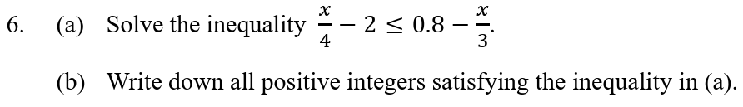










































$$\text{x}$$
$$\text{x}$$
(a)
$$−$$
$$\text{2}$$
$$≤$$
$$\text{0.8}$$
$$−$$
4
3
$$\text{x}$$
$$\text{x}$$
$$\text{12}$$
$$−$$
$$\text{2}$$
$$≤$$
$$\text{12}$$
$$\text{0.8}$$
$$−$$
4
3
$$\text{3}\text{x}$$
$$−$$
$$\text{24}$$
$$≤$$
$$\text{9.6}$$
$$−$$
$$\text{4}\text{x}$$
$$\text{3}\text{x}$$
$$+$$
$$\text{4}\text{x}$$
$$≤$$
$$\text{9.6}$$
$$+$$
$$\text{24}$$
$$\text{7}\text{x}$$
$$≤$$
$$\text{33.6}$$
$$\text{33.6}$$
$$\text{x}$$
$$≤$$
7
$$\text{x}$$
$$≤$$
$$\text{4.8}$$
The required positive integers are 1, 2, 3 and 4.
(b)

Slide 7





































$$\text{4}\text{x}+\text{3}$$
$$\text{1}−\text{3}\text{x}$$
$$<$$
$$+$$
$$\text{4}$$
5
6
$$\text{4}\text{x}+\text{3}$$
$$\text{1}−\text{3}\text{x}$$
$$\text{30}$$
$$<$$
$$\text{30}$$
$$+$$
$$\text{4}$$
5
6
$$+$$
$$\text{18}$$
$$<$$
$$−$$
$$\text{15}\text{x}$$
$$+$$
$$\text{24}\text{x}$$
$$\text{5}$$
$$\text{120}$$
$$\text{24}\text{x}$$
$$+$$
$$\text{15}\text{x}$$
$$<$$
$$+$$
$$\text{120}$$
$$−$$
$$\text{18}$$
$$\text{5}$$
$$\text{39}\text{x}$$
$$<$$
$$\text{107}$$
29
$$\text{x}$$
$$<$$
$$\text{2}$$
39
$$∴$$
The required positive integers are 1 and 2.

Slide 8
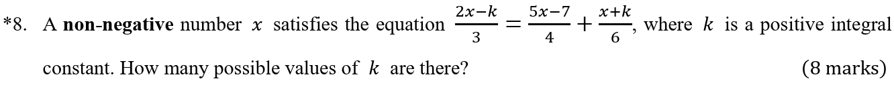










































































$$\text{2}\text{x}−\text{k}$$
$$\text{5}\text{x}−\text{7}$$
$$\text{x}+\text{k}$$
$$∵$$
$$=$$
$$+$$
x is non-negative.
3
4
6
$$\text{7}$$
$$−$$
$$\text{2}\text{k}$$
$$\text{2}\text{x}−\text{k}$$
$$\text{5}\text{x}−\text{7}$$
$$\text{x}+\text{k}$$
$$∴$$
$$≥$$
$$\text{0}$$
$$\text{12}$$
$$=$$
$$\text{12}$$
$$+$$
$$\text{3}$$
3
4
6
$$\text{7}$$
$$−$$
$$\text{2}\text{k}$$
$$≥$$
$$\text{0}$$
$$\text{8}\text{x}$$
$$−$$
$$\text{4}\text{k}$$
$$=$$
$$\text{15}\text{x}$$
$$−$$
$$\text{21}$$
$$+$$
$$\text{2}\text{x}$$
$$+$$
$$\text{2}\text{k}$$
$$−\text{2}\text{k}$$
$$≥$$
$$−\text{7}$$
$$\text{8}\text{x}$$
$$−$$
$$\text{15}\text{x}$$
$$−$$
$$\text{2}\text{x}$$
$$=$$
$$−\text{21}$$
$$+$$
$$\text{2}\text{k}$$
$$+$$
$$\text{4}\text{k}$$
1
$$\text{k}$$
$$≤$$
$$\text{3}$$
2
$$−\text{9}\text{x}$$
$$=$$
$$−\text{21}$$
$$+$$
$$\text{6}\text{k}$$
$$−\text{21}$$
$$+$$
$$\text{6}\text{k}$$
$$∵$$
k is a positive integer.
$$\text{x}$$
$$=$$
$$−\text{9}$$
$$∴$$
The possible values of k are 1, 2 and 3.
$$\text{7}$$
$$−$$
$$\text{2}\text{k}$$
$$=$$
$$\text{3}$$
$$\text{i}\text{.}\text{e}\text{. }\text{There} \text{are} \text{3} \text{possible} \text{values} \text{of} \text{k}\text{. }$$

